Slide 1
DevOps in an Embedded Environment
By Arjun Comar

Slide 2
What’s the Problem?
What exactly do we mean by embedded?
Git Flow in a Regulated World
Building Software
Deployment
Scalability and Resource Concerns
Questions

Slide 3
Embedded?

Slide 4
Common Problems
Limited Tooling
Cross-compilation
Unvirtualizable

Slide 5
Abiomed Specifically
Limited Tooling
Unix without the niceties
sh or ksh, no bash
telnet and ftp, not ssh and rsync
No python, ruby, etc.
“What do you mean it doesn’t have dhcp? It’s 2016...”
Cross-compilation
x86 environment
Windows build, QNX target
Some components need WinXP to build
Unvirtualizable
Hardware only, manufactured in house

Slide 6
Additional Challenges
Unit Testing can’t be done on the CI server
Regulated environment
Staff processing a culture change

Slide 7
Git Flow
in a Regulated World

Slide 8
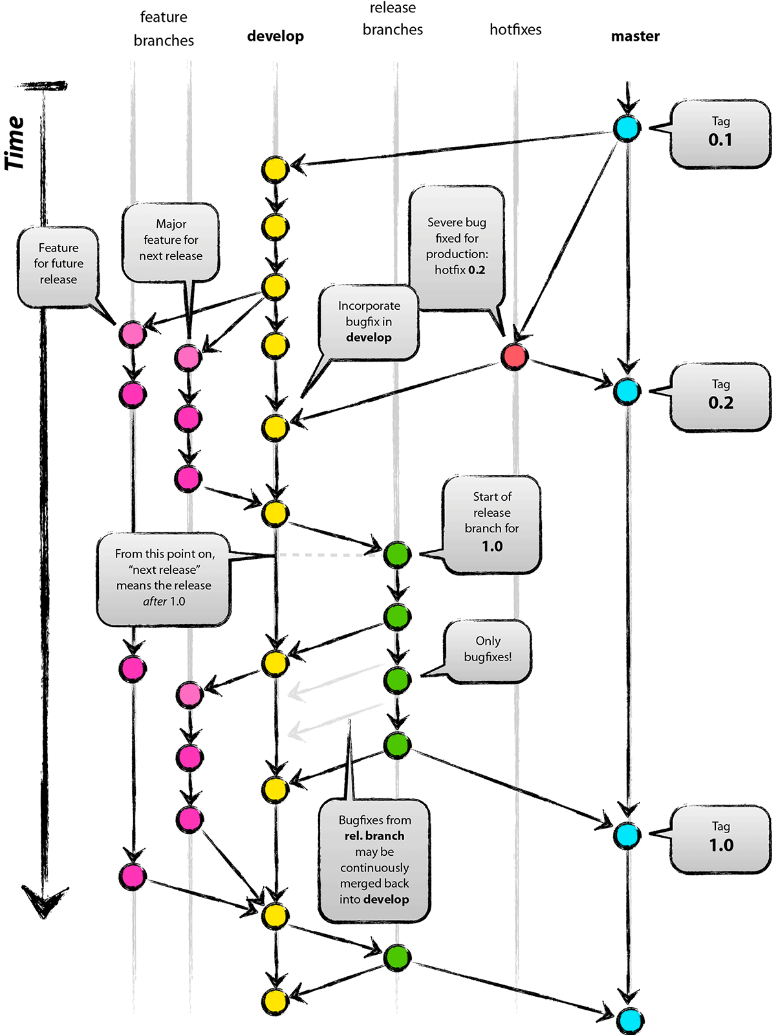

Slide 9
Normal Git Flow
Preserve single main line of development
Integrate back to it daily
Supports easy CI

Slide 10
What Everyone Always Winds Up Doing
Make feature branches
Integrate as late as possible
Give up on CI
Pray that what you built and what you delivered were the same thing

Slide 11
Regulatory Environment
New features might not get approved in time for a release
They might never get approved
Need to keep them separate from releasable channels

Slide 12
Supporting multiple lines of dev
CI/CD on all lines of development
‘development’ branch is for approved code only
‘master’ gets released code
Testing happens independently on separate branches
Don’t work directly on the feature branches

Slide 13
Integration
Every feature branch should be up to date with development
All feature branches should be mergable
Enforce this with tooling!

Slide 14
Building Software

Slide 15
What already exists
Makefile based build infrastructure
Tied to a particular directory
Already used by the developers

Slide 16
Enforcing CI
Jenkins Workflow Multibranch Plugin
Build on push to any branch
Push build artifacts to nexus, track where it came from

Slide 17
Deployments

Slide 18
Ouch
Limited tooling really bites
Unmaintained infrastructure
Team believed networked deployments to be impossible

Slide 19
First things first...
Get a build package onto the console
Work out what needs to happen to install it
Lots of bricked consoles...

Slide 20
Expect, Lifesaver
Script the interaction!
Separate interacting with the console from what happens on the console
$ cat login.expect
#!/usr/bin/expect
set timeout 20
set addr [lindex $argv 0]
set user [lindex $argv 1]
set pass [lindex $argv 2]
spawn telnet $addr
expect "login:"
send "$user\r"
expect "Password:"
send "$pass\r"
expect "#"
interact

Slide 21
Expect, Lifesaver
Deploying becomes:
Side load build artifact
Side load install script
Run install script on build artifact
Unit Testing becomes:
Side load unit tests
Side load execution script
Execute script

Slide 22
Console Manipulation
No choice but sh
Minimize what needs to be done
Longest script:
Turn services off
Clean up old files
Unpack new files into place
Restart to turn everything back on

Slide 23
Scalability and Resource Concerns

Slide 24
Basic Math
Need one box for:
CI, Deployment Testing, Smoke Testing
Unit Testing
Functional Testing
Loooong waits if we try to do all this on the same box

Slide 25
Basic Math, continued
Each branch needs support
If we want to support 3-4 active branches of development
Two legacy maintenance branches
~14 consoles to support development team

Slide 26
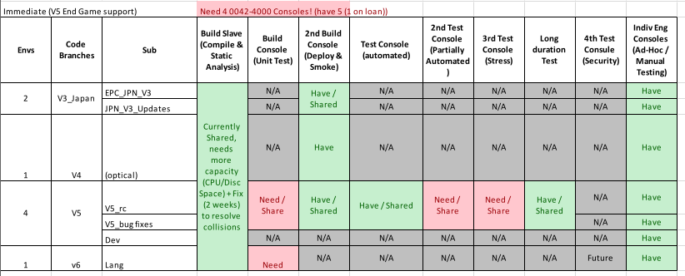

Slide 27
Basic Math, continued^2
What about testing?
Durability testing
Performance testing
Partially automated tests?
Security testing?
All require different lengths of time
Run on different schedules
Once per sprint is probably ideal

Slide 28
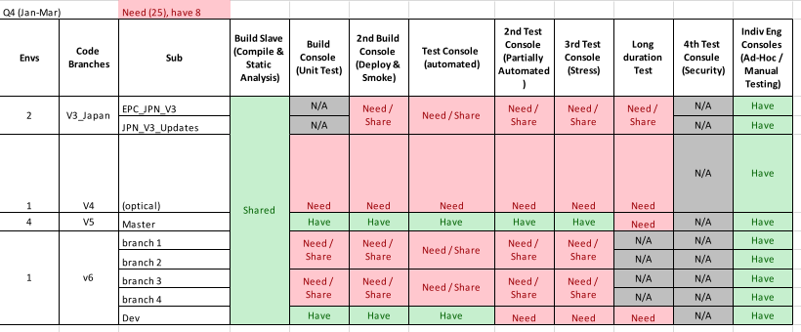

Slide 29
What’s that add up to?
Oh, what about test automation development?
DevOps development?
Okay, Okay, 28 consoles.
How much is that going to cost?
Notice this is all needed short term to support immediate development...

Slide 30
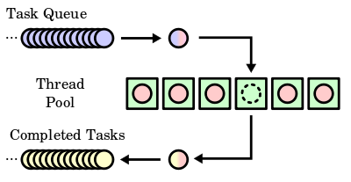
Medium Term
Build a resource manager
Create a pool of consoles
Allocate consoles to requesting clients
Need separate pools depending on hardware capabilities

Slide 31
Shorter Term
Locking!
Jenkins with Workflow turned out to be fairly useless for this…
Old linux trick: drop a lockfile
def locking(box, block) {
acquireLock(box)
try {
block()
} finally {
clearLock(box)
}
}
downloadTests(latest)
locking(1.2.3.4) {
deploy(1.2.3.4, myBuild)
runTests(1.2.3.4, myBuild, testTags)
}

Slide 32
Questions?
(Or god I miss AWS)

